Slide 1
Azure Cosmos DB
Data Modeling & Optimization

Slide 2
Session's objectives
Understand key data modeling concepts and best practices
Understand key concepts for partitioning
Apply them to a real-world scenario
Understand how Cosmos DB differs from relational databases when designing a data model

Slide 3
What is Azure Cosmos DB?
Microsoft's NoSQL database on Azure
Non-relational and
horizontally scalable

Slide 4



What is Azure Cosmos DB?
horizontally scalable
Unlimited throughput
Unlimited storage capacity
Notes:
So let’s talk about the horizontal scale aspects of Cosmos DB.
<Click> Unless your workload is very small with a low amount of data and requests, your data will likely be<click> stored on a number of different physical servers or partitions within something we call a container. Now in Cosmos we abstract all this away but under the hood you’re reading and writing data in and out of Cosmos, across a cluster of servers.
This is better known as “scale out” and its how we achieve horizontal scalability, enabling: <CLICK>
Unlimited storage. So when you need more storage, we simply add more servers to your cluster.
<CLICK> This also provides unlimited throughput as each server adds additional capacity <click> to handle requests when you need it.

Slide 5

What is Azure Cosmos DB?
non-relational
Notes:
Cosmos DB is also “non-relational”.
Now when working with relational databases, you have the ability to <CLICK> define relational constraints between the different entities you're storing. This lets you define things like foreign keys between entity types and perform JOIN operations across these entity types. <click>
Non-relational databases like Cosmos DB don't implement these relational constraints. Why?

Slide 6
What is Azure Cosmos DB?
non-relational
and horizontally scalable
Notes:
Well because Cosmos is horizontally scalable and your data will likely be spread across multiple servers – tens or hundreds depending on your storage and throughput requirements.
Now I don’t want to suggest that its not technically possible to enforce relational constraints across a cluster of servers but doing so would have an enormous impact on the performance, and availability for your database.
And because Cosmos DB is designed to provide predictable performance, Cosmos does not provide a way to declare relational constraints.

Slide 7
So is Cosmos DB suitable for relational workloads?
It sure is!
Most workloads in Cosmos are actually relational
Different techniques used to implement relationships
Not intuitive. Relational best practices don't translate well and may even be anti-patterns!
Notes:
So is Cosmos DB ok to use for relational workloads?
<click> YES! It definitely is. In fact most workload on Cosmos are relational.
<click> You just need to learn to use different techniques to implement the relationships between your entities.
The approach is very different than designing a data model for a relational database.
<click> For those that are new to this type of database you should not follow your intuitions. Best practices in the relational world don’t translate well to this type of database and may even be anti-patterns.

Slide 8
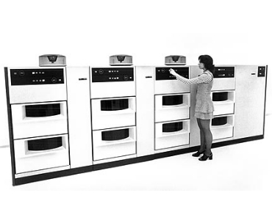
Storage in 1970
IBM 3330 data storage
200 MB to 1600 MB
$74,000-$87,000 (1970)
$567K - $666K (2022)

Slide 9
Comparing relational vs. NoSQL
1MB of storage in 1970 =~$2000-3000 ^{1|2}
1GB of storage in 1970 = $2,500,000
1GB of storage in Cosmos DB today = $.25c
If I’m designing database storage in 1970 what am I optimizing for?
Today compute, relative to storage is more expensive.
NoSQL databases optimize for compute (requests) vs. storage.
[1] - https://jcmit.net/diskprice.htm
[2] – Inflation rate 666.14% 1970 - 2022

Slide 10
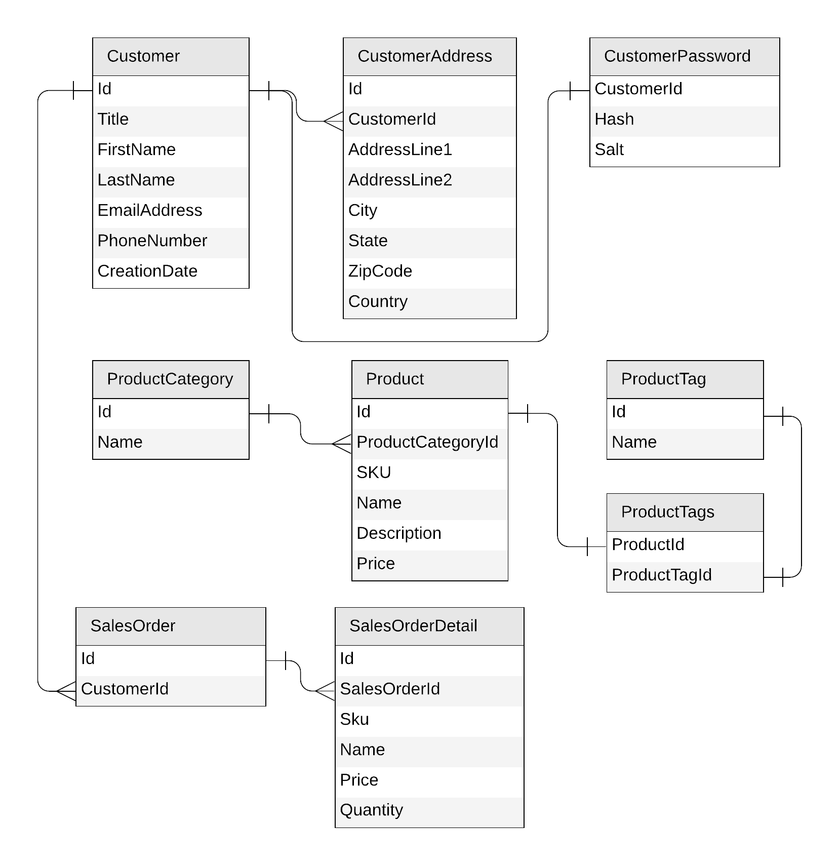
Let's look at a concrete example
E-commerce workload
Customers
Products
Categories
Tags
Sales Orders
Notes:
Ok so let’s put this to practice. I’m going to spend the rest of this session taking a relational database that anyone who’s used SQL Server should know, the Adventure Works 2017 database. Well actually just a small part of it.
These tables represent the canonical ecommerce workload. We’ve got <click though the tables as you read them out>
With a non-relational document database like Cosmos DB, there isn't much we can do with that. You would never use these tables as is because the cost and performance for trying to perform operations on the data would be prohibitive.
Another thing I want to point out too is that in a relational database, the relationships between data are important for modeling the database. For a NoSQL database these are only part of the story. What is most important when designing a data model for a NoSQL database is the access patterns for your application. As I will show you throughout this talk, the design decisions we're going to make rely on these access patterns to the data.

Slide 11
Identifying the operations for our app
Create a customer
Edit a customer
Retrieve a customer
Create a product category
Edit a product category
List all product categories
Create a product tag
Edit a product tag
List all product tags
Create a product
Edit a product
List all products from a category (with name of category and tags)
Create a sales order
List all sales order for a customer
Query top 10 customers by number of sales orders
Notes:
A real e-commerce platform would obviously need to implement many more kinds of requests, but this subset is enough to guide our first implementation and illustrate the different design techniques we want to showcase.
Here’s what our mini ecommerce site will have to do…

Slide 12
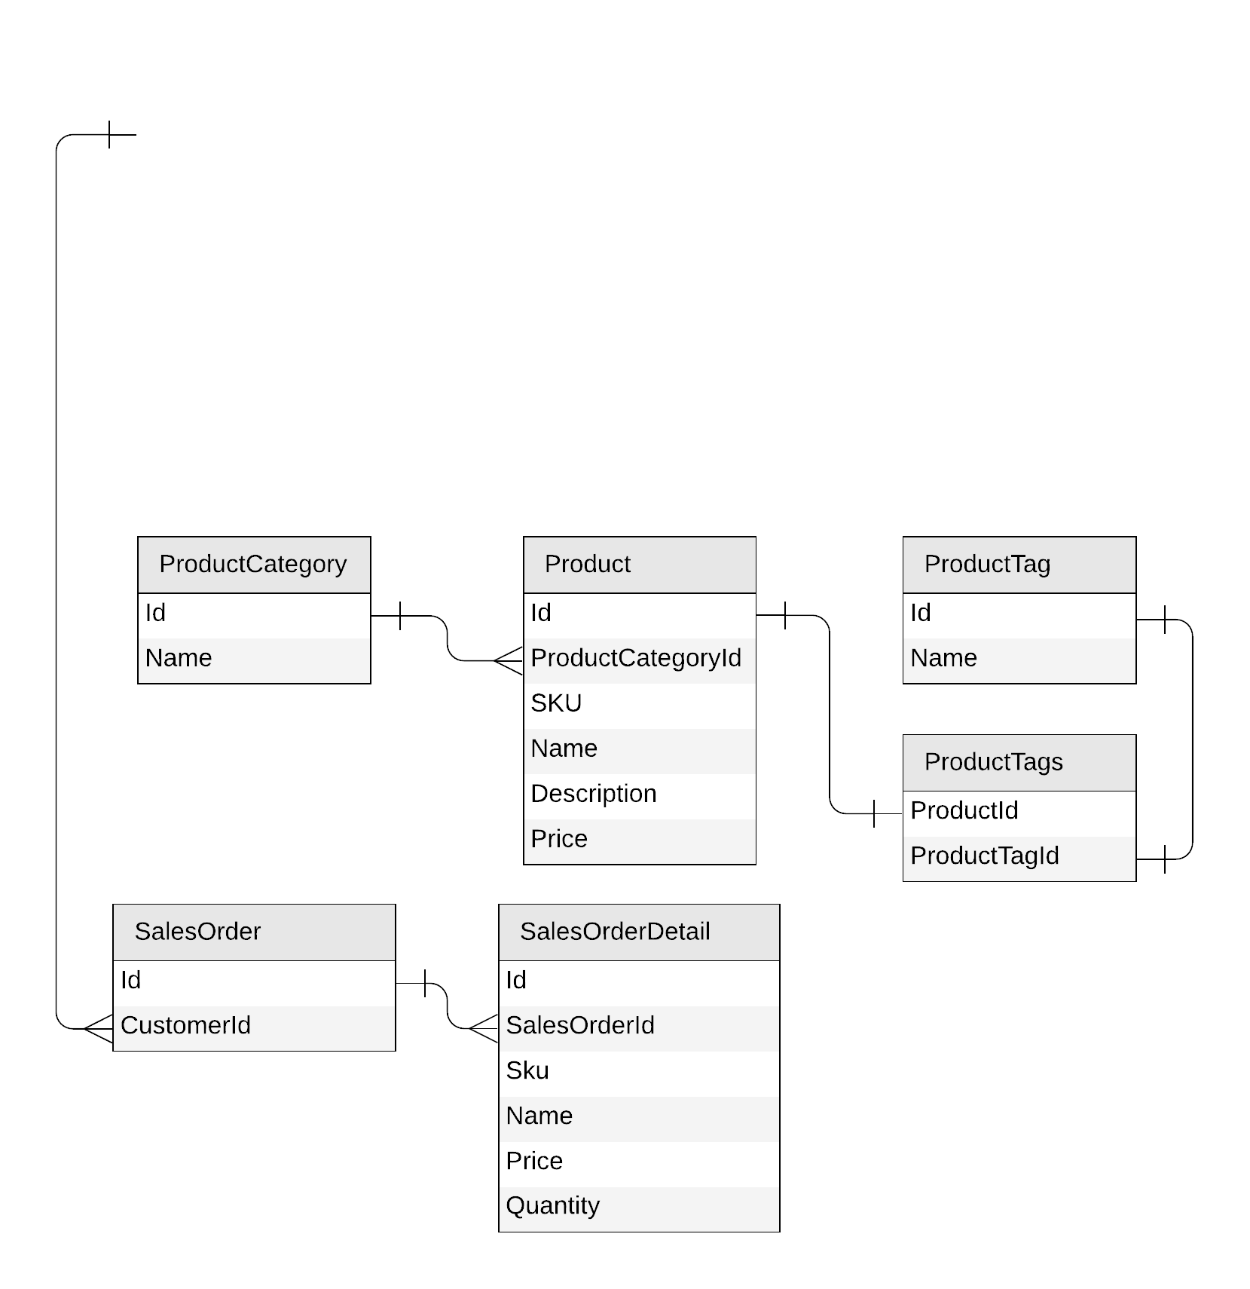
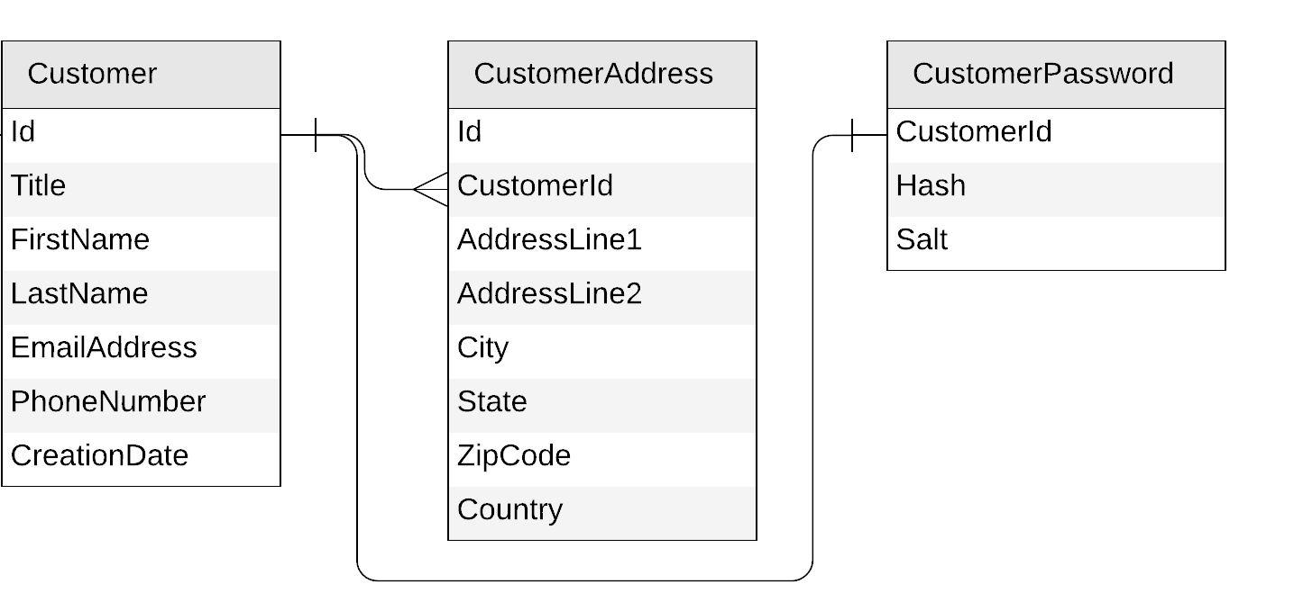
Let’s get started!
Notes:
Ok so let’s get started re-modeling this relational database in Cosmos DB

Slide 13
Starting with the Customer entity
Create a customer
Edit a customer
Retrieve a customer
{
"id": "…",
"title": "…",
"firstName": "…",
"lastName": "…",
"emailAddress": "…",
"phoneNumber": "…",
"creationDate": "…"
}
{
"id": "…",
"customerId": "…",
"addressLine1": "…",
"addressLine2": "…",
"city": "…",
"state": "…",
"zipCode": "…",
"country": "…"
}
{
"id": "…",
"customerId ": "…",
"hash": "…",
"salt": "…"
}
Notes:
Let’s start with the customer entities.
We have three tables here.
<Click> First we will translate each table to a corresponding JSON document.
Now we could keep these in separate containers in Cosmos but let’s look at what operations we need to support. That includes both creating a customer and retrieving a customer.
Given that Cosmos DB stores data as JSON another approach we could take is to <click>

Slide 14
Starting with the Customer entity
{
"id": "…",
"title": "…",
"firstName": "…",
"lastName": "…",
"emailAddress": "…",
"phoneNumber": "…",
"creationDate": "…",
"addresses": [{
"addressLine1": "…",
"addressLine2": "…",
"city": "…",
"state": "…",
"zipCode": "…",
"country": "…"
}],
"password": {
"hash": "…",
"salt": "…"
}
}
Notes:
Embed the address and password tables into our customer table.
Now when I create a new customer, I only need to insert data into a single container.
Reading data is also easier because I only need to read from a single container as well.
Let’s go into the portal and run the queries necessary to get all of the customer data we need.
So both operations are now both faster and less expensive to execute because I’ve embedded the data into a single container.

Slide 15
To embed or to reference?
{
"id": "…",
"title": "…",
"firstName": "…",
"lastName": "…",
"emailAddress": "…",
"phoneNumber": "…",
"creationDate": "…",
"addresses": [{
"addressLine1": "…",
"addressLine2": "…",
"city": "…",
"state": "…",
"zipCode": "…",
"country": "…"
}],
"password": {
"hash": "…",
"salt": "…"
}
}
{
"id": "…",
"title": "…",
"firstName": "…",
"lastName": "…",
"emailAddress": "…",
"phoneNumber": "…",
"creationDate": "…"
}
{
"id": "…",
"customerId": "…",
"addressLine1": "…",
"addressLine2": "…",
"city": "…",
"state": "…",
"zipCode": "…",
"country": "…"
}
{
"id": "…",
"customerId ": "…",
"hash": "…",
"salt": "…"
}
Notes:
So, at this point people often ask. When would you embed data verses when you would reference it?

Slide 16
To embed or to reference?
Embed when:
1:1 relationship
1:few relationship
Related items are queried or updated together
Reference when:
1:many relationship (especially if unbounded)
Many:many relationship
Related items are queried or updated independently
though patch() can help with client side resources

Slide 17
Our first entity: Customer
{
"id": "…",
"title": "…",
"firstName": "…",
"lastName": "…",
"emailAddress": "…",
"phoneNumber": "…",
"creationDate": "…",
"addresses": [{
"addressLine1": "…",
"addressLine2": "…",
…
}],
"password": {
"hash": "…",
"salt": "…"
}
}
Notes:
Because we have 1:1 and 1:few relationships between our entities, and because we usually retrieve all the data corresponding to a customer at once, it makes sense to embed everything in the same JSON document.

Slide 18
Customer
{
"id": "…",
"title": "…",
"firstName": "…",
"lastName": "…",
"emailAddress": "…",
"phoneNumber": "…",
"creationDate": "…",
"addresses": [{
"addressLine1": "…",
"addressLine2": "…",
…
}],
"password": {
"hash": "…",
"salt": "…"
}
}
customer
PK: ?
Notes:
Now that we have defined our first entity we will store our customers in a container named 'customer’.
When creating a new container, we also have to define its partition key… And you may be asking, well what is a partition key?

Slide 19
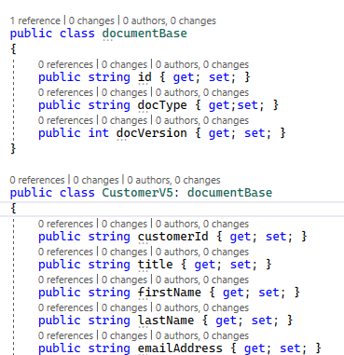
Key tips on document modeling
Keep small but matched to access patterns
1K=10RU
256K=~100RU
500K=~200RU
1MB=~1000RU
Shred documents with highly asymmetrical access patterns
Flatter (3 max to keep optimal)
Cheaper & faster to index
Cheaper & faster to serialize & deserialize
Indexing using “all except” pattern, so new properties are indexed
Create a base document class when mixing entities and versioning

Slide 20
What is partitioning?
Notes:
<click> Remember earlier I referred to a Cosmos DB container as an abstraction over a cluster of physical servers.

Slide 21

What is partitioning?
logical partitions
Notes:
When storing documents in a Cosmos DB container, these documents end up being dispatched to different physical servers. So the question is, how do I decide that this document should go to this server, and that document to that server?
Technically, we're not directly assigning documents to servers. Instead, documents are being written to <click> logical partitions, and it's these logical partitions that sit on different physical servers.
<click> And so from a user's perspective, you don't really need to care about physical servers when designing your data model; just that your data gets written to different logical partitions.
So how do I decide which logical partition a document should go to?

Slide 22
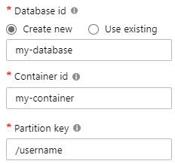
What is partitioning?
Andrew
Mark
Deborah
Tim
Luis
Theo
Notes:
Well that's where the partition key comes in! When creating a new Cosmos DB container, you define the container's partition key, which is the name of the property Cosmos DB will use to decide which logical partition your data should go to. Think of it as an address to route your data.
<click> Using the example of a container partitioned by username, we would end up with a logical partition with data where username equals Andrew, a second logical partition with data where username equals Deborah, and so on.

Slide 23
What is partitioning?
Max size: 2 MB
Max size: 20 GB
Notes:
There are 2 constraints to keep in mind when designing your data model on Cosmos DB:
Each document has a max size of 2 MB. Remember before when I talked about when to embed or reference? Well one reason is because each document can be no larger than 2MB which is why you don’t want unbounded arrays in your documents. It also is not efficient if you have a document that is frequently updated, growing larger each time.
<click> Also Each logical partition has a max size of 20 GB, so you can't have more than 20 GB of documents where username equals Andrew

Slide 24

What is partitioning?
Notes:
When working with data, we want to strive to achieve an even distribution of data across our different logical partitions. If one partition gets a lot more data stored on it than the others, this is what we call <click> a hot partition, and we want to avoid that.

Slide 25


Hierarchical partition keys
https://aka.ms/cosmos-hierarchical-partitioning

Slide 26
What is partitioning?
Notes:
Same goes for the requests as well.
If all or most of your <click> requests hit the same logical partition, <click> this is going to be a bottleneck that will drastically limit the overall scalability of your model.

Slide 27

Redistribute throughput (preview) https://aka.ms/CosmosRedistributeThroughput

Slide 28

Dynamic Scaling https://aka.ms/CosmosDynamicAutoscale

Slide 29
What is partitioning?
Notes:
We want to end up with a design where storage and throughput are more or less evenly distributed across our different logical partitions.

Slide 30

What is partitioning?
Andrew
Deborah
Tim
Mark
Luis
Theo
SELECT * FROM c WHERE c.username = 'Mark'
our partition key
Notes:
So the partition key plays an important role in both performance and scalability.
<click> Let's take again the example of a container partitioned by username. If we were to issue this SQL query, you'd notice that it filters on the 'username' property, <click> which is our partition key.
And because Cosmos DB understands that, it will send this query to a single partition. <click>
That means this query will always hit <click> one single physical server, so its performance will always be good.

Slide 31
What is partitioning?
Andrew
Deborah
Tim
Mark
Luis
Theo
SELECT * FROM c WHERE c.favoriteColor = 'orange'
?
Notes:
If our query filtered on something else, <click> like 'favoriteColor' here, we would have no idea where the actual results are. So in this case, <click> Cosmos DB fans-out the query to each and every logical partition. And as you've probably guessed already, this is going to hit each <click> underlying physical server.
This is what we call a cross-partition query, more specifically this is a fan-out query, meaning it will hit every single physical partition. Such a query will work, but will have an impact on the latency, throughput cost and scalability.
Now for small containers this performance impact is not that bad. In fact, for a container with just a single physical partition you will not notice any impact in performance at all. However, as your database grows larger, the impact becomes more and more worse as you have to hit more and more servers to answer your query.
And it’s this scenario precisely that traps so many people new to this type of database. Typically developers will do dev and test on a small dataset and conclude that their design is good because the performance they measured was acceptable. In a NoSQL database you don’t truly know if your design is scalable until you actually measure under load or have a very good idea of the concurrency of your operations.

Slide 32
Physical vs logical partitions
Max RU: 10K
Max size: 20 GB
logical partitions
Max size: 50 GB

Slide 33
Physical vs logical partitions
Max RU: 10K
Max size: 20 GB
logical partitions
Max size: 50 GB

Slide 34
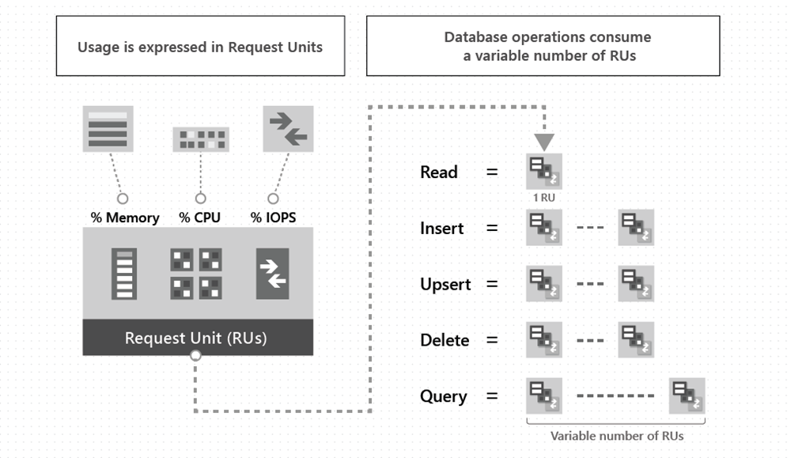
What is an RU?
Per SECOND!
Amortize over time
Monthly batch job
100,000 documents (~1kb)
10 RU/s insert
1M RU total
Cost to insert
1 second?
10 seconds?
1 minute?
1 month?
learn.microsoft.com/azure/cosmos-db/request-units
Notes:
1 second = 1 million RU = $80/hour
10 seconds = 100,000 RU = $8/hour
1 minute = 17,000 RU = $1.36/hour
1 month = 4 RU (1000 RU/s = .08c)

Slide 35
Key tips on Throughput
Throughput and partitions are bound to each other
Heuristic for partition splits is more aggressive at container creation than afterwards.
Massive scale-up then down again can result in throughput fragmentation and 429’s later
100,000 RU = 10 partitions
If I go from 100,000 RU -> 1,000 RU then…
1000 RU/10 = 100 RU/partition (too little compute to do much)
Read this before doing any major scale up
learn.microsoft.com/azure/cosmos-db/scaling-provisioned-throughput-best-practices

Slide 36
Choosing a partition key for customers
{
"id": "…",
"title": "…",
"firstName": "…",
"lastName": "…",
"emailAddress": "…",
"phoneNumber": "…",
"creationDate": "…",
"addresses": [{
"addressLine1": "…",
"addressLine2": "…",
…
}],
"password": {
"hash": "…",
"salt": "…"
}
}
customer
PK: ?
Notes:
Now with all that knowledge about partitioning, how do we choose the right partition key for our customers?

Slide 37
Choosing a partition key for customers
customer
PK: ?
Create a customer
Edit a customer
Retrieve a customer
(by id)
Notes:
Remember before when I showed the operations we needed to do for customers?
We had three things to do. We need to create a customer, edit a customer and we also need to retrieve a customer. <click> In this case we’ll do this by their id.

Slide 38
Choosing a partition key for customers
customer
PK: id
Create a customer
Edit a customer
Retrieve a customer
(by id)
Notes:
So the id of the JSON documents we're going to store in this container should make for a suitable partition key.

Slide 39
Choosing a partition key for customers
customers
PK: id
Notes:
Note that when using the id as the partition key, we end up with as many logical partitions as there are documents in the container, with each partition containing only one document.
And that’s actually perfectly fine! Many users are concerned about having a very high number of logical partitions, but no need to worry.
Logical partitions are a virtual concept. Cosmos DB co-locates logical partitions on the same physical servers and moves them to different physical servers when needed. And there's no upper limit to how many logical partitions you can have in a container.

Slide 40
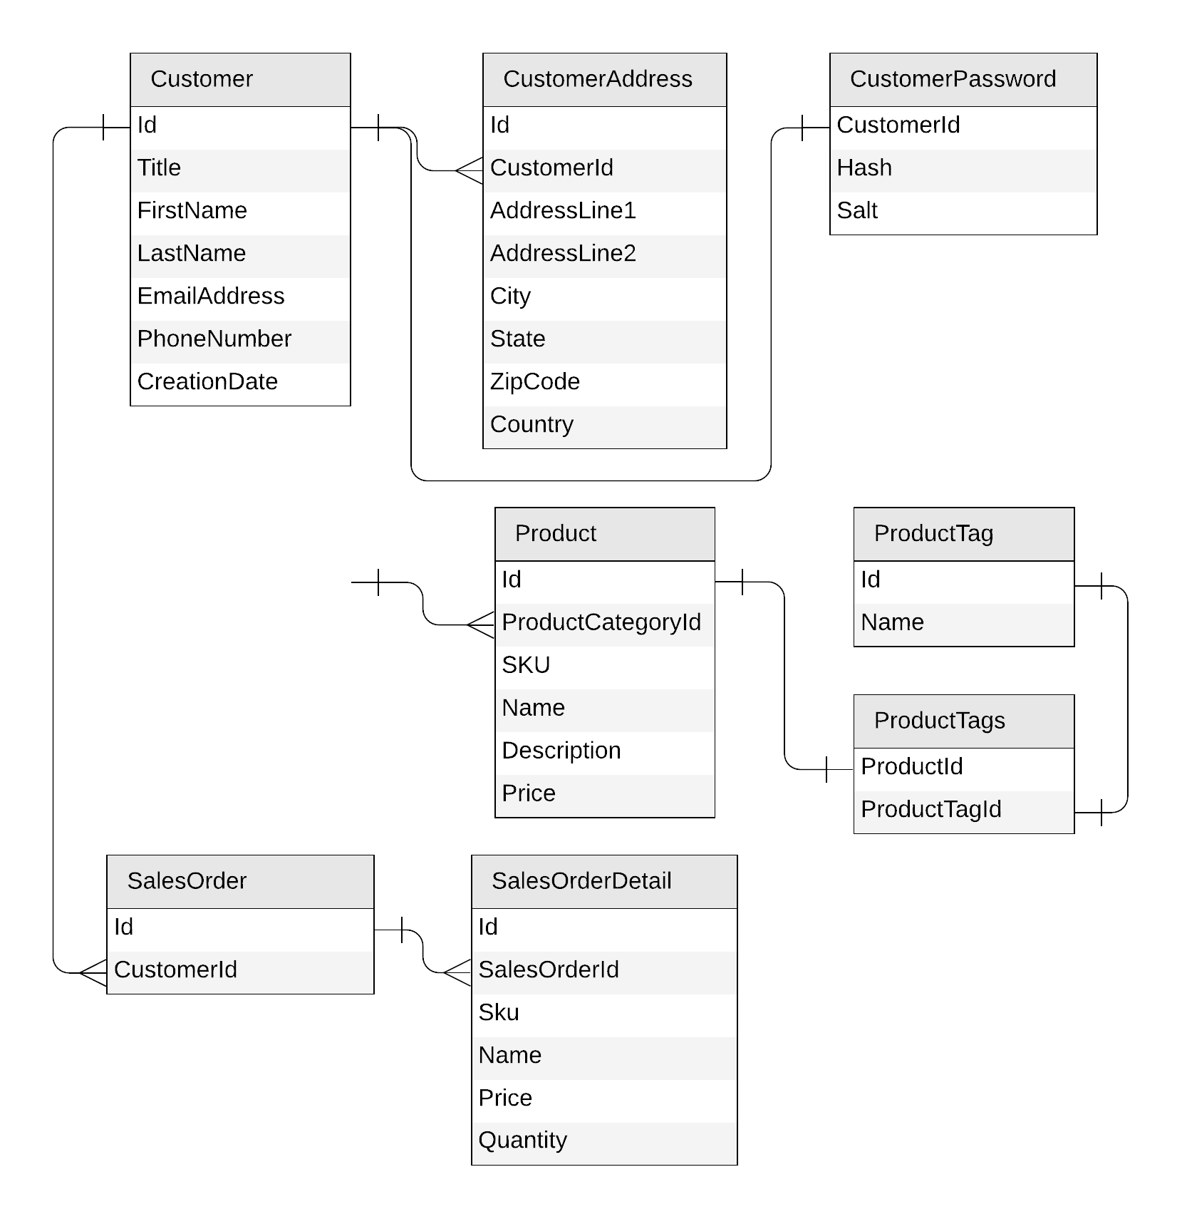
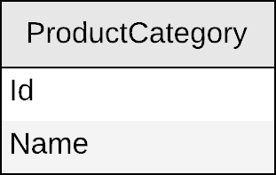
Next: products
Notes:
Ok, next let’s look at the product tables

Slide 41
Product category
{
"id": "…",
"name": "…"
}
Notes:
First up is the product category table.
We will do the same thing we did earlier, which is translating the entity into a JSON document.

Slide 42
Product category
productCategory
PK: ?
{
"id": "…",
"name": "…"
}
Notes:
And we will store that document in a new container called 'productCategory’.
Next, we need to figure out what its partition key should be.

Slide 43
Product categories
productCategories
PK: ?
Create a product category
Edit a product category
List all product categories
SELECT * FROM c
Notes:
Again, we look at the requests we'll need to support in our app.
Here we need to create a product category and edit a category.
<click> We also need to list all product categories. <click>
Again I want to point that when looking at the operations you need to support, it’s important to know the volume of those operations as well.
For instance, we probably aren’t creating or editing product categories very often. But the query to list all product categories happens very frequently.
There’s another issue here however. There’s no WHERE filter on this query. So how do we make this a single partition query?

Slide 44
Product category
productCategory
PK: type
{
"id": "…",
"name": "…",
"type": "category"
}
SELECT * FROM c WHERE
c.type = “category”
Notes:
Well the answer is to use a little trick we can apply here and create a new property and give it a constant value in our document.
Here I’ve created a property called type and given it a value of category.
Now I can partition by this 'type' property set a value of 'category' in each document.
Now I realize some people may think looks a bit weird. But later on I’m going to iterate on this design and you’ll see how this actually makes sense.

Slide 45
Demo
Query product categories
Notes:
Ok so in this demo I’ll show you the query for product categories and we will measure its RU charge in our app.
Demo C

Slide 46
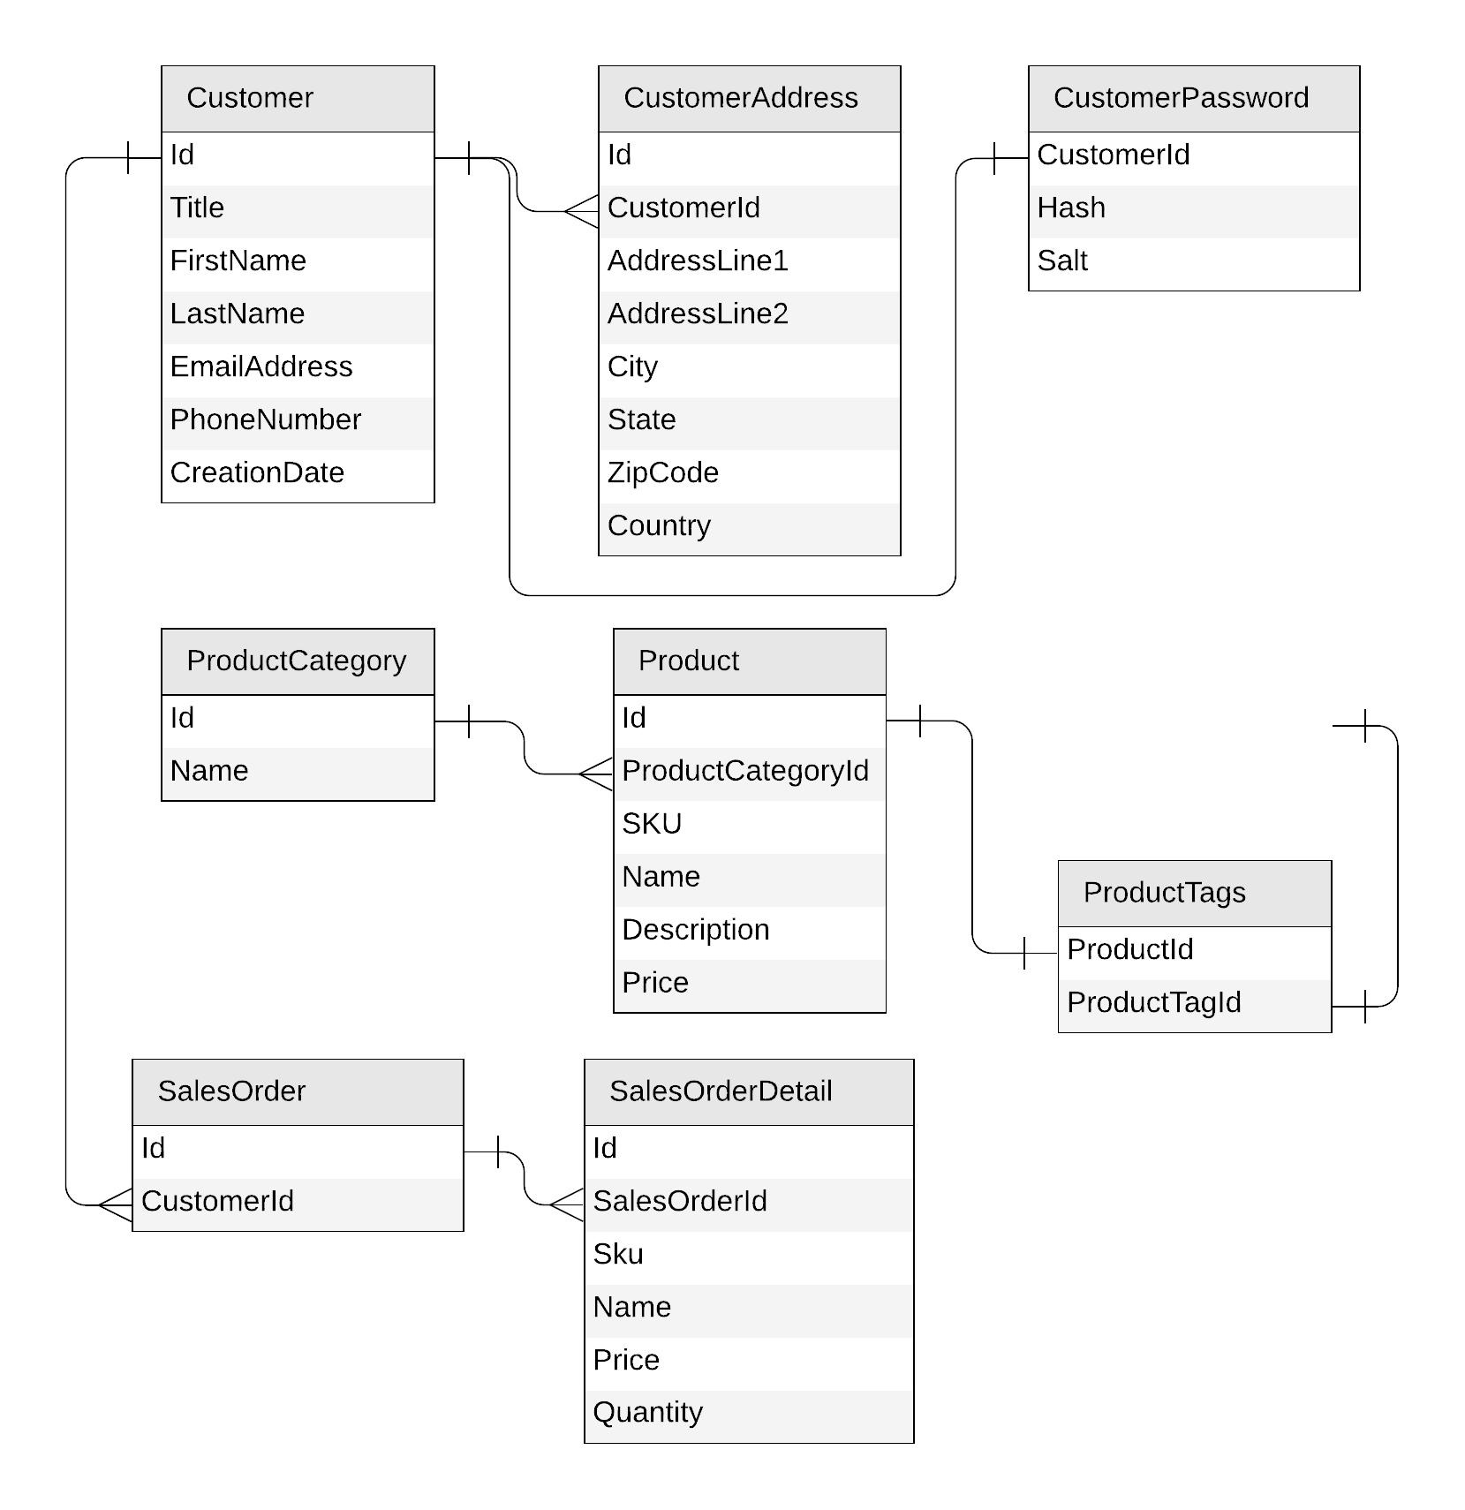
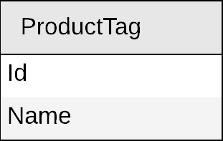
Next: product tag
Notes:
Ok, next let’s look at product tags.

Slide 47
Product tag
{
"id": "…",
"name": "…"
}
Notes:
I’ll apply the same process for product tags, by defining a JSON document.

Slide 48
Product tag
productTag
PK: ?
{
"id": "…",
"name": "…"
}
Notes:
And we will store tags in its own container named 'productTag'.

Slide 49
Product tag
productTag
PK: ?
Create a product tag
Edit a product tag
List all product tags
Notes:
Now it turns out that tags actually share the exact same access patterns as categories.
So we'll just go ahead and apply the same strategy here.

Slide 50
Product tag
productTag
PK: type
{
"id": "…",
"name": "…",
"type": "tag"
}
Notes:
And we will partition the container by 'type’. And set its value to 'tag’ for each document.

Slide 51
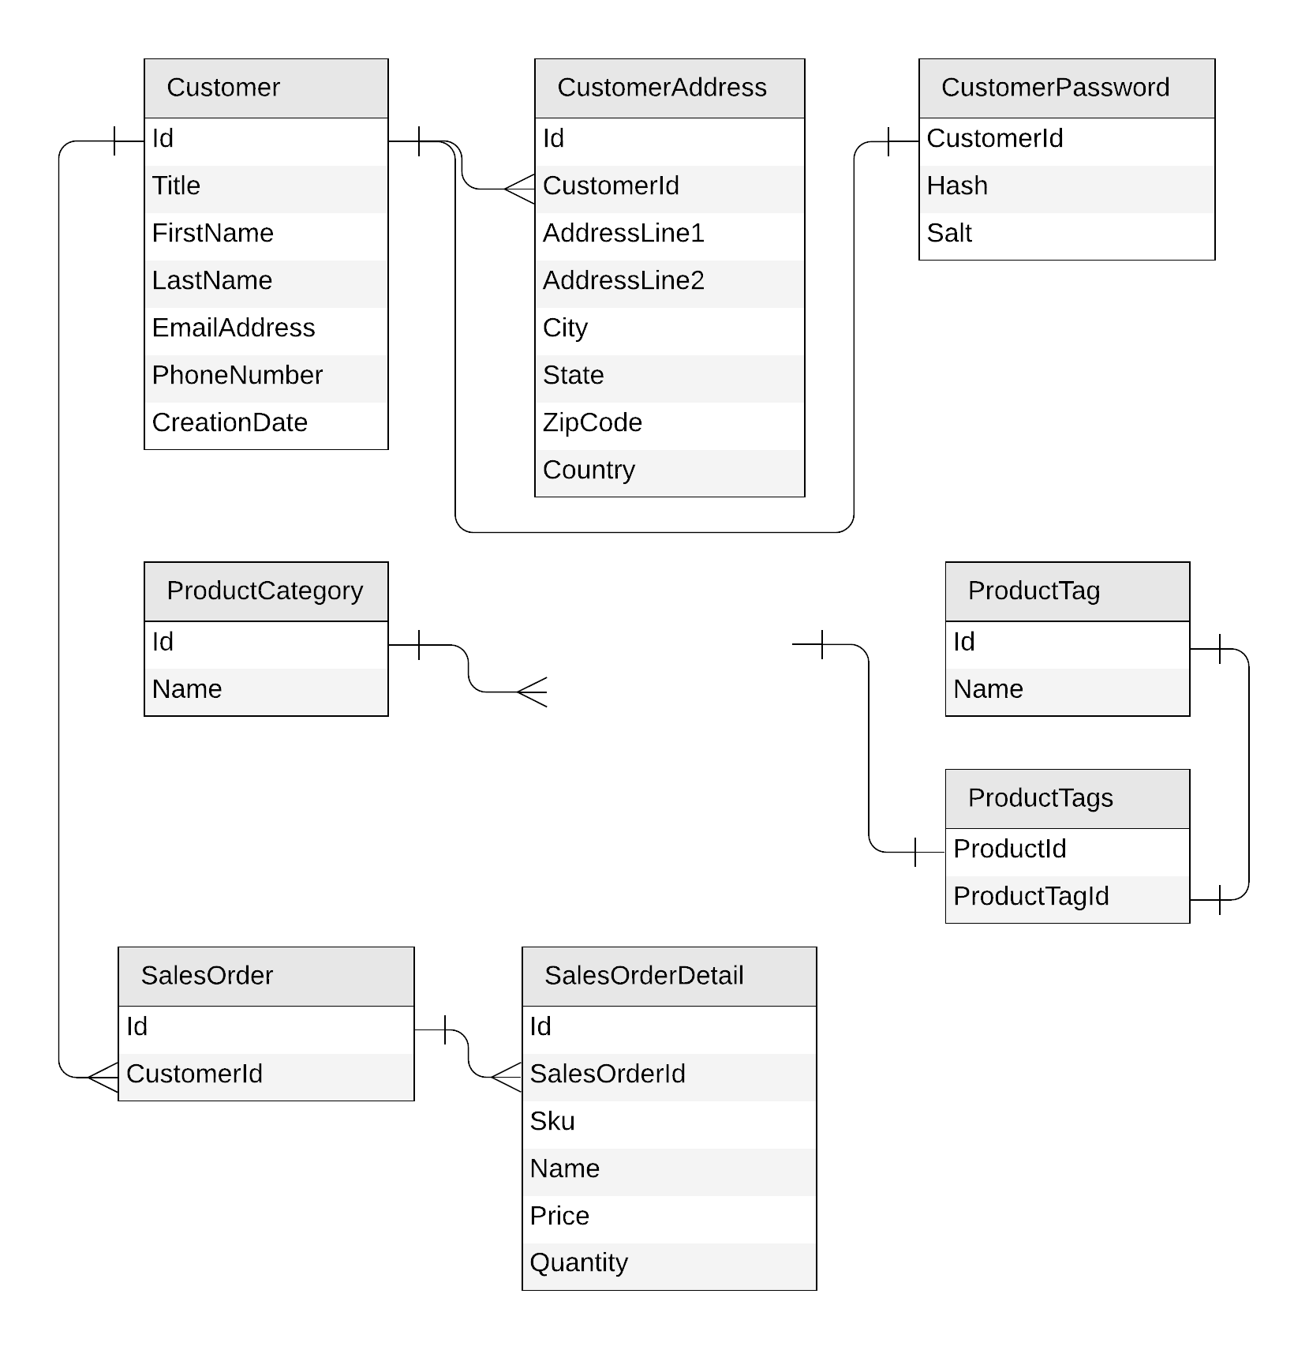
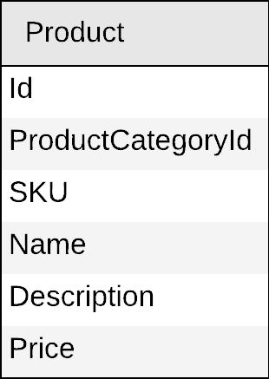
Next: product
Notes:
Ok, next let’s look at the product table.

Slide 52
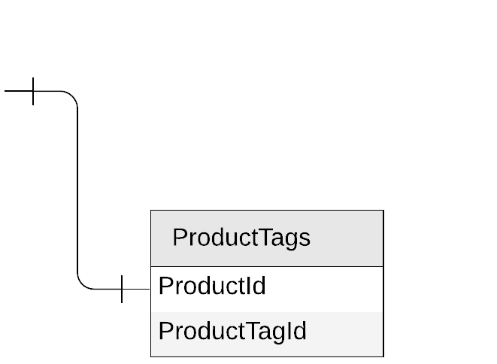
Product
{
"id": "…",
"categoryId": "…",
"sku": "…",
"name": "…",
"description": "…",
"price": …
}
Notes:
First, I’ll translate my schema to JSON.
<click> Next I want to look at the relationship to the productTags table.
Our product table here has a many to many relationship with tags.
I need to access the productTags in my application meaning that when I display a product I need the tags to appear as well.
I also need to be able to query for a product using tags.
Now I could do this in one of two ways. I could store the product info in the productTags table, or I could materialize the tags in my product table.

Slide 53
Products
{
"id": "…",
"categoryId": "…",
"sku": "…",
"name": "…",
"description": "…",
"price": …,
"tagIds": [
"…",
"…"
]
}
Notes:
Now given there are much fewer tags per product than products per tags it makes more sense to materialize the productTags and embed them in my product table.
Remember too that there is a 1:few relationship between product and tags so this too makes it a good candidate for embedding.

Slide 54
Products
{
"id": "…",
"categoryId": "…",
"sku": "…",
"name": "…",
"description": "…",
"price": …,
"tagIds": [
"…",
"…"
]
}
product
PK: ?
Notes:
Next we will store products in their own container, named 'product'.

Slide 55
Products
Create a product
Edit a product
List all products from a category (with name of category and tags)
products
PK: ?
SELECT * FROM c WHERE c.categoryId = 'CategoryA'
CategoryA
CategoryB
CategoryC
Notes:
Next let’s figure out a good partition key.
Again, we will look at the operations we need to perform and decide on a partition key.
We of course need to create and edit a product.
But the interesting operation is querying for a product by category. This is likely how customers will search for products.
We need to list all the products that match a specific category, so the corresponding <click>
SQL query would be "SELECT * FROM c WHERE c.categoryId = 'CategoryA’”.
This will return all products for that category.
In order to make this query single-partition, <click> we would need to have all products from the same category sit in the same logical partition.

Slide 56
Products
{
"id": "…",
"categoryId": "…",
"sku": "…",
"name": "…",
"description": "…",
"price": …,
"tagIds": [
"…",
"…"
]
}
category name?
product
PK: categoryId
tag names?
Notes:
So 'categoryId' is a good partition key here, as it will allow us to retrieve all products in a category very efficiently.
<click> But now the problem is that every time I query for products in that category, I get a category ID and a bunch of tag IDs.
What I really need is to display the category name and a list of tag names in each product.

Slide 57

Products: how to return category and tag names?
product
SELECT * FROM c WHERE c.categoryId = 'CategoryA'
WHERE ARE MY JOINS?
productCategory
SELECT c.name FROM c WHERE c.id = 'CategoryA'
productTag
SELECT * FROM c
WHERE c.id IN ('<tagId1>', '<tagId2>', '<tagId3>')
Notes:
In order to achieve that, I would need to first run my query that I defined on products…
<click> Then issue a second query on my product Categories container to retrieve the name of the category…
<click> And then for each product returned, issue multiple queries to fetch the corresponding tag names.
Now this would work, but it's not very scalable. And you may be asking yourself <click> hey why not just use joins?

Slide 58
Introducing denormalization
When working with non-relational databases, we optimize our data models to make sure that all the required data is ready to be served by the queries
Notes:
Well as I mentioned previously. Cosmos DB is a non-relational data store. It doesn’t support joins across containers.
Data that is modeled in this type of data store is optimized such that it can be served in a single request.

Slide 59
Products: denormalizing category and tag names
{
"id": "…",
"categoryId": "…",
"categoryName": "…",
"sku": "…",
"name": "…",
"description": "…",
"price": …,
"tags": [
{
"id": "…"
"name": "…"
},
{
"id": "…"
"name": "…"
},
]
}
product
PK: categoryId
Notes:
So to our products table we are going to add additional properties including:
<click> The name of the category
<click> and the name for each for each tag
By doing this, we make sure that we can retrieve all the data we eventually need to return to the clients in just one request.

Slide 60
Demo
Query a product with category name and tag names
Notes:
Ok so let’s see what that looks like when we add the category and tag names into our products container.
Show ListAllProductCategories ()
Demo D

Slide 61
Products: keeping everything in sync
productCategory
ProductCategory
product
Product
productTag
ProductTag
Notes:
So now when we create a new product we will need to populate these additional properties. <click>
But what if we rename a category or a tag?
How do we manage that “referential integrity” between containers?
Well as it turns out Cosmos DB has a way to handle that.

Slide 62

Cosmos DB's change feed
The change feed is an API exposed by Cosmos DB containers
It streams any change happening in a container (document creation or update)
Notes:
And it’s called Change Feed.
Change Feed is an API that lives within every Cosmos DB container. <click> When ever any data is written to Cosmos DB, such as an insert or an update, Change Feed streams these changes to an API that you can listen to and then use that event to respond to the data that was changed.

Slide 63

Products: keeping everything in sync
productCategory
product
productTag
Notes:
So in our case we will have listen to changes that occur to our product categories container as well as the product tags container. <click>
And every time data is updated, it will also propagate the change to the products container accordingly.

Slide 64
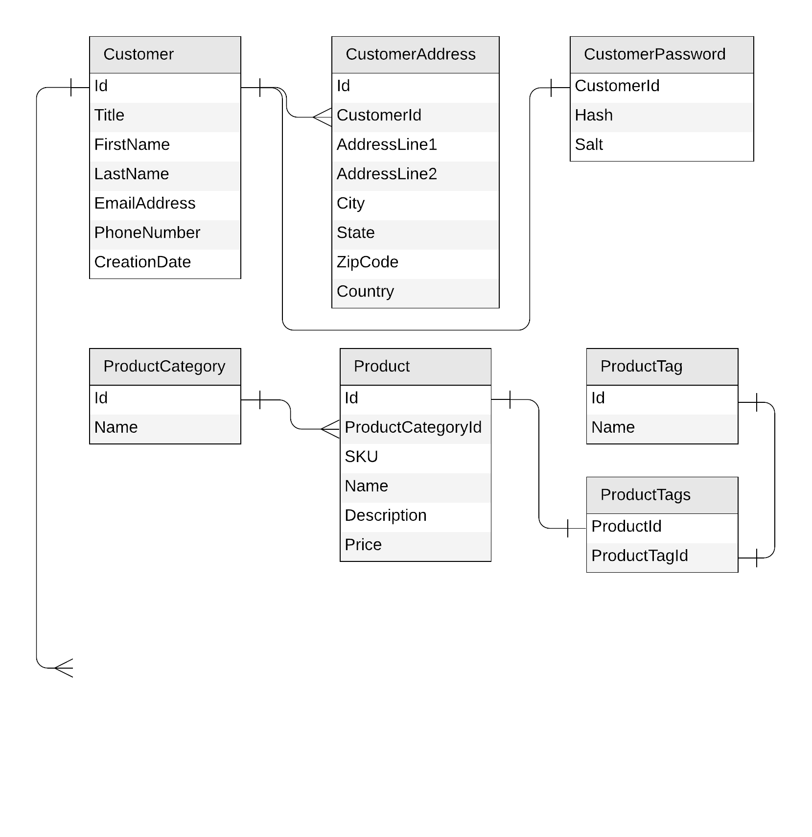
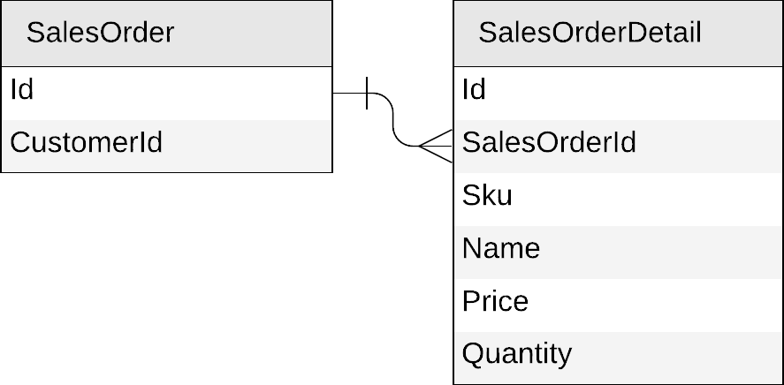
Next: sales orders
Notes:
Ok, we’re now on to our last entity, sales orders.

Slide 65
Sales orders
{
"id": "…",
"customerId": "…"
}
{
"id": "…",
"salesOrderId": "…",
"sku": "…",
"name": "…",
"description": "…",
"price": …,
"quantity": …
}
Notes:
Same process as before, we start by creating the JSON for each entity.

Slide 66
Sales orders
{
"id": "…",
"customerId": "…",
"details": [{
"sku": "…",
"name": "…",
"description": "…",
"price": …,
"quantity": …
}]
}
Notes:
This is obviously another good candidate for embedding because it’s a 1:few relationship.
And it also makes sense to embed the details with the sales order so we can query for the entire order with a single efficient point read.

Slide 67
Sales orders
{
"id": "…",
"customerId": "…",
"details": [{
"sku": "…",
"name": "…",
"description": "…",
"price": …,
"quantity": …
}]
}
salesOrder
PK: ?
Notes:
And next we will store sales orders in its own container.

Slide 68
Sales orders
salesOrder
PK: ?
Create a sales order
List all sales orders for a customer
Query top 10 customers by number of sales orders
Notes:
So let’s look again at the expected operations to decide on the partition key.
So of course we need to create a new sales order…

Slide 69
Sales orders
salesOrders
PK: ?
Create a sales order
List all sales order for a customer
SELECT * FROM c WHERE c.customerId = 'CustomerA'
CustomerA
CustomerB
CustomerC
Notes:
And we need to list all sales order for a customer. Let’s look at this first query.
"SELECT * FROM c WHERE c.customerId = 'CustomerA’”. <click>
So to make sure this is a single-partition query, we would need all sales order for a customer to sit in the same logical partition.

Slide 70
Sales orders
{
"id": "…",
"customerId": "…",
"details": [{
"sku": "…",
"name": "…",
"description": "…",
"price": …,
"quantity": …
}]
}
salesOrder
PK: customerId
Notes:
So we’ll make customer Id our partition key here.

Slide 71
Sales orders
{
"id": "…",
"customerId": "…",
"details": [{
"sku": "…",
"name": "…",
"description": "…",
"price": …,
"quantity": …
}]
}
salesOrder
PK: customerId
{
"id": "…",
"title": "…",
"firstName": "…",
"lastName": "…",
"emailAddress": "…",
"phoneNumber": "…",
…
}
customer
PK: id
Notes:
Before we go any further, let's take a step back.
When looking at the containers we've defined so far, it's interesting to note that we already have a container that is partitioned by the customer’s id, and that is the customers container.
So could we store customers and sales orders in the same container?

Slide 72
Mixing entities in the same container?
YES!
Leverage the schema-agnostic nature of Cosmos DB
Suitable when different entity types
share similar access patterns
share the same partition key
Notes:
The answer is definitely <click> YES!
Not only is this technically possible, it is a best practice for a NoSQL database.
<click> Cosmos DB is schema-agnostic so this is something that is totally supported.
<Click> And is suitable when data share similar access patters and share the same partition key.

Slide 73
Sales orders
{
"id": "…",
"customerId": "…",
"details": [{
"sku": "…",
"name": "…",
"description": "…",
"price": …,
"quantity": …
}]
}
salesOrder
PK: customerId
{
"id": "…",
"title": "…",
"firstName": "…",
"lastName": "…",
"emailAddress": "…",
"phoneNumber": "…",
…
}
customer
PK: id
Notes:
So instead of storing customers and sales orders in the different containers

Slide 74
Sales orders: mixing with customers
{
"id": "…",
"customerId": "…",
"details": [{
"sku": "…",
"name": "…",
"description": "…",
"price": …,
"quantity": …
}]
}
customer
PK: id
{
"id": "…",
"title": "…",
"firstName": "…",
"lastName": "…",
"emailAddress": "…",
"phoneNumber": "…",
…
}
Notes:
I’m going to put them both in the customers container.

Slide 75
Sales orders: mixing with customers
{
"id": "…",
"customerId": "…",
"details": [{
"sku": "…",
"name": "…",
"description": "…",
"price": …,
"quantity": …
}]
}
customer
PK: customerId
{
"id": "…",
"customerId": "…",
"title": "…",
"firstName": "…",
"lastName": "…",
"emailAddress": "…",
"phoneNumber": "…",
…
}
Notes:
I’m also going to change the partition key from id to customer Id
And I’ll also add customerId as a property to each customer document.
Customer documents now will have the same value for id and the new customer Id partition key property.

Slide 76
Sales orders: mixing with customers
{
"id": "…",
"type": "salesOrder",
"customerId": "…",
"details": [{
"sku": "…",
"name": "…",
"description": "…",
"price": …,
"quantity": …
}]
}
customer
PK: customerId
{
"id": "…",
"type": "customer",
"customerId": "…",
"title": "…",
"firstName": "…",
"lastName": "…",
"emailAddress": "…",
"phoneNumber": "…",
…
}
Notes:
Next, to help distinguish the sales order and customer entities within the container
I’ll also add an additional 'type' property that has the value of “customer” and “salesOrder” for each entity.
This way I can query for each separately if I want.

Slide 77
Sales orders: mixing with customers
customer
sales orders
customers
PK: customerId
CustomerA
CustomerB
CustomerC
Notes:
Ok, so now what we have is a customers container where each logical partition will contain exactly one customer row and all that customer’s sales orders.

Slide 78
Sales orders
customer
PK: customerId
Create a sales order
List all sales order for a customer
SELECT * FROM c WHERE c.customerId = 'CustomerA' AND c.type = 'salesOrder'
Notes:
And so now to get all of the sales orders for a customer we simply run with this updated query here.
SELECT * FROM c WHERE c.customerId = 'CustomerA' AND c.type = 'salesOrder'

Slide 79
Sales orders
customer
PK: customerId
Create a sales order
List all sales orders for a customer
Query top 10 customers by number of sales orders
Notes:
Finally, let's look at the last request we need to serve.
We want to query our top 10 customers based upon the number of sales orders they’ve had.
This request requires you to count the number of sales orders for each customer
Then sort these counts in descending order, and then return the first 10 corresponding customers.
Even though customers and sales orders sit in the same container, this is not something you can currently do with Cosmos DB's query language.

Slide 80
Denormalizing the count of sales orders
{
"id": "…",
"type": "customer",
"customerId": "…",
"title": "…",
"firstName": "…",
"lastName": "…",
"emailAddress": "…",
"phoneNumber": "…",
"creationDate": "…",
"addresses": [{
"addressLine1": "…",
"addressLine2": "…",
…
}],
"password": {
"hash": "…",
"salt": "…"
}
}
Notes:
Once again, the solution is to denormalize.

Slide 81
Denormalizing the count of sales orders
{
"id": "…",
"type": "customer",
"customerId": "…",
"title": "…",
"firstName": "…",
"lastName": "…",
"emailAddress": "…",
"phoneNumber": "…",
"creationDate": "…",
"addresses": [{
"addressLine1": "…",
"addressLine2": "…",
…
}],
"password": {
"hash": "…",
"salt": "…"
},
"salesOrderCount": …
}
Notes:
This time, we're going to denormalize the count of sales orders in the customer entity.

Slide 82
Denormalizing the count of sales orders
customer
sales orders
customers
PK: customerId
CustomerA
CustomerB
CustomerC
Notes:
So what we want to achieve is that…

Slide 83
Denormalizing the count of sales orders
update the customer
add a sales order
customers
PK: customerId
CustomerA
CustomerB
CustomerC
Notes:
Every time we add a sales order, <click> we also update the corresponding customer to increment its count of sales orders.
Here we can benefit from the fact that each customer and their sales orders sit in the same logical partition.
And Cosmos DB supports transactions for data sitting in the same logical partition.
So these 2 operations can be performed in a transaction with a stored procedure or using a new feature in our SDK called Transactional Batch.

Slide 84
Sales orders
customer
PK: customerId
Create a sales order
List all sales order for a customer
Query top 10 customers by number of sales orders
SELECT TOP 10 * FROM c WHERE c.type = 'customer'
ORDER BY c.salesOrderCount DESC
Notes:
And so our last request can now be served with this query.
SELECT * FROM c WHERE c.type = 'customer’ ORDER BY c.salesOrderCount DESC

Slide 85
Sales orders
customer
PK: customerId
Create a sales order
List all sales order for a customer
List customers by descending number of sales orders
SELECT TOP 10 * FROM c WHERE c.type = 'customer'
ORDER BY c.salesOrderCount DESC
Notes:
I don’t know if you noticed but that last query was a cross partition query.
Remember before I said that you want to try to avoid these.
But in reality, they are ok for operations like this that aren’t run very frequently.
It’s also important to keep in mind that its not necessary to make every query a single partition query.
This is both not practical and often does not save enough money to pursue.
When analyzing your access patterns, the key is to ensure that those operations that are run most frequently are the ones you want to focus on.
Queries like this one that may get run once a month are not a big deal.

Slide 86
Our final design
customer
PK: customerId
Customer
productTag
PK: type
ProductTag
SalesOrder
product
PK: categoryId
productCategory
PK: type
Product
ProductCategory
Notes:
Ok so we’re nearly at the end remodeling our database.
So far we've created the following containers to support our design for our ecommerce application.
We have a customers container that contains both customers and sales order entities.
We have a products container that contains products and denormalized product category and product tags.
And we have a container each for product category and product tags.
But there’s one more place where we can optimize even further.
Notice that both product category and product tag share the same partition key…

Slide 87
Our final design
productCategory
PK: type
ProductCategory
productMeta
PK: type
ProductTag
ProductCategory
productTag
PK: type
ProductTag
SELECT * FROM c WHERE c.type = ‘category'
SELECT * FROM c WHERE c.type = ‘tag'
Notes:
And as you may have guessed.
Because they share that same partition key, we can just group them together in the same container, which we could rename to 'productMeta’.
Now we can use queries like these to get all our product tags and all our product categories.
In fact, this pattern works for any kind of master or reference data you need to maintain.

Slide 88
Our final design, optimized!
customer
PK: customerId
Customer
SalesOrder
productMeta
PK: type
ProductTag
ProductCategory
product
PK: categoryId
Product
Notes:
So here is our final design optimized. We’ve gone from 9 tables in our relational database to just three containers. All of them optimized to serve our e-commerce application at scale and do so efficiently.

Slide 89
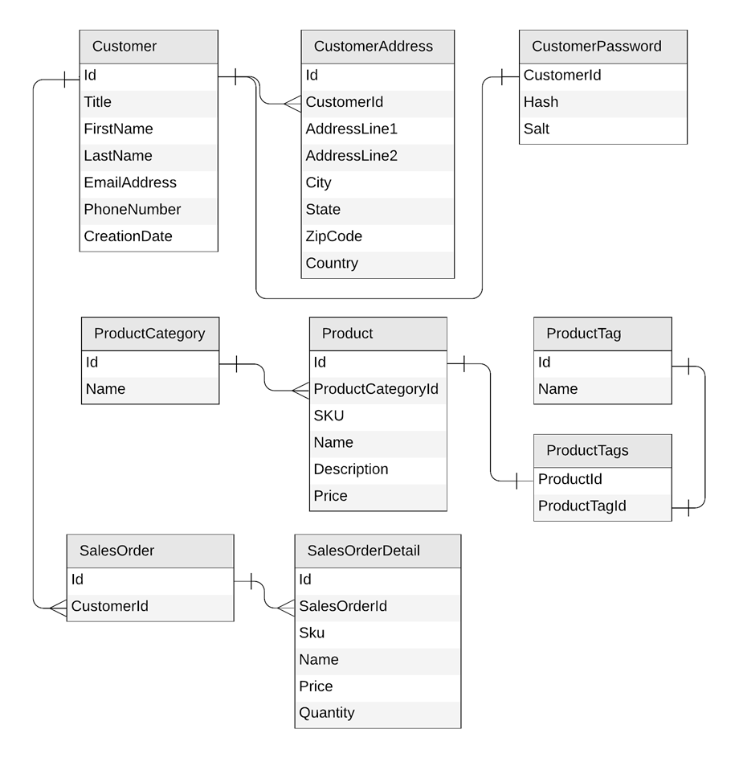
Original Relational Model

Slide 90
Key takeaways
Identify key access patterns and design for them
Partitioning is critical for best performance and scalability
Materialize relations between entities by:
Embedding
Denormalizing and pre-aggregating
Storing related entities in the same container
Different methods to implement denormalization
Using the change feed
Using stored procedures or transactional batch
Notes:
So key take aways in today’s session.
Always start by looking at the access patterns for your data and design around the most important and used operations.
Partitioning is absolutely critical to achieving optimal performance and scale.
A container with a good partition strategy will provide the same performance and latency regardless of size.
You want to materialize the relationships between your entities either by:
-embedding them
-denormalizing and aggregating
-and storing related entities together.
Finally, you want to use the tools built into Cosmos DB itself to manage the denormalization including change feed, stored procedures or even better, transactional batch.

Slide 91
Going further
Demos and links to sample data.
github.com/AzureCosmosDB/CosmicWorks
github.com/AzureCosmosDB/CosmicWorksJava
New Microsoft Learn Labs
https://aka.ms/msl-modeling-partitioning-1
https://aka.ms/msl-modeling-partitioning-2
Awesome videos
youtube.com/azurecosmosdb
Monthly User Group
meetup.com/azure-cosmos-db-global-user-group
Weekly Live Podcast
aka.ms/CosmosDBLiveTV
Notes:
So if you’re interested in getting the demos you saw today as well as the data and resources to try this yourself, feel free to checkout the link here at the top on GitHub.
The second link here is for an article that goes through some of what I showed here today but uses a blog platform as the use case.
Also definitely check out all our awesome videos out on our you tube channel.
And finally, gotcosmos.com which has links to lots of great content as well as our blog.

